Slide 1
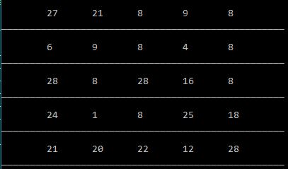
War of Divisors

Slide 2
Presented by:
Khairul Anam Mubin
ID : 17182103286
Afsana Jahan Toma
ID : 17182103291
Intake: 38
Section: 07
Department of CSE
BUBT.

Slide 3
We gladly thank to our project instructor:
Hisham Siddique Lecturer Dept. of CSE BUBT.

Slide 4
Introduction
It’s a console based simple game.
It’s a single player and a Multiplayer game.
It’s a simple mathematical game and which is going to improve mathematical skills

Slide 5
Objectives of the project:
To create a project (console game) using C/C++ programming language and their features.
To implement features like control statement, conditional statement, 2D array, loops statement, random function etc.
To make the program easy while running it.
To concise the memory of program as far as possible.
To get an idea about making a simple project using C/C++.
To be able to solve problems by Compiling and Debugging.

Slide 6
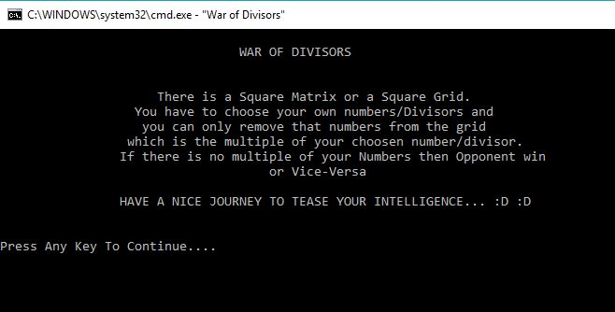
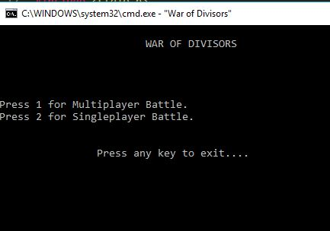
Game rules:
There are two mode:
1. Single Player
2. Multi Player
There are three level in Single player mode.
1.Easy
2. Medium
3.Hard

Slide 7
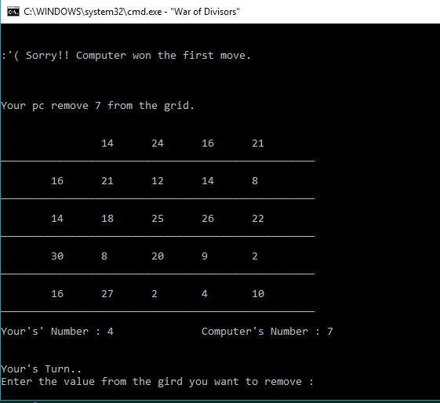
Game rules
For single player:
Run the game & press 2 for playing in single mode.
Choose the game level. 1 for easy 2 for medium and 3 for hard.
By choose a number from 3 to 9 to start game and going through a toss.
Who win the toss the removing is start from him. Thus he have to remove the multiple of that number only.
If opponent have no multiple left then the others win.

Slide 8
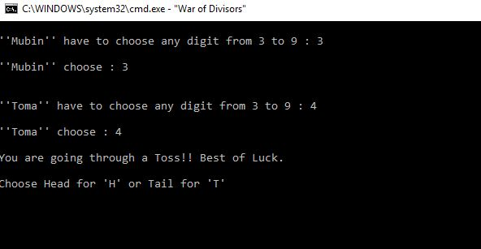
Game rules:
For Multiplayer player:
Run the game & press 1 for playing in Multiplayer mode.
Insert the player 1 and player 2 name.
Chose numbers and after it go through a toss which is going to decide who will remove the first multiple.
If opponent have no multiple left others win.

Slide 9
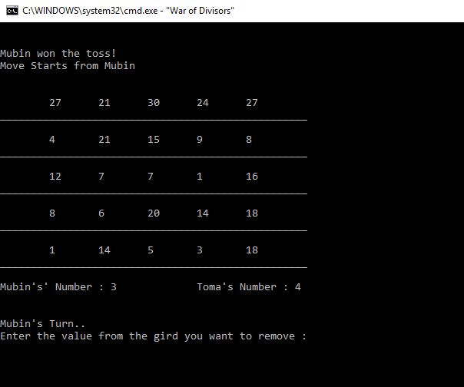
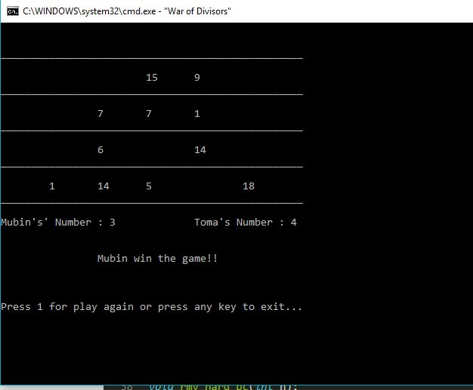
Game rules:

Slide 10
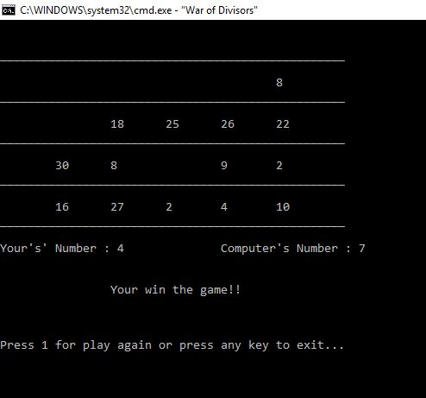
Game rules:
After finishing game you can choose to play again or exit.
Press 1 for play again
Press any key for exit.

Slide 11

limitation:
This game cannot be played by more than two player.
It’s not a high level game.
As the numbers generates in the grid randomly so sometimes grid doesn’t contain good numbers

Slide 12

Development:
In this game we can play single or Multiplayer mode. But we can make it playable for more than 2 player.
We can develop it’s wining process.
We can make it as online game.

Slide 13


